Slide 1

Bangladesh Now
Team 10 (RegExp)

Slide 2
The Concept
An application to provide an easy way to access all the information provided by a2i. With just a single click or a simple search term.

Slide 3
Features of Bangladesh Now
Keyword based search and intelligent tracking.
Filtering result based on location, time/date and help from synonym and translation provided by google.
Category based selection and nested search.
User friendly and Bengali language based interface.

Slide 4
What we Developed in GDG
Information Collection Algorithm
Finding out information sources
Paper Sketch
Paper Prototype
Digital Wireframe
PSD UI Mockup
Primary Project Presentation

Slide 5
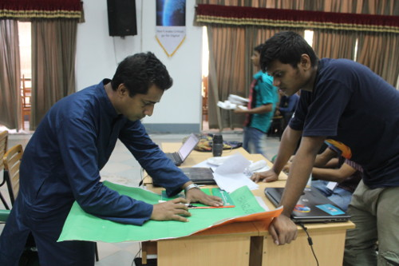
Paper Sketch with Domain Expert

Slide 6
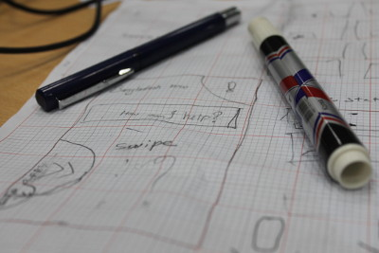
Paper Wireframing

Slide 7
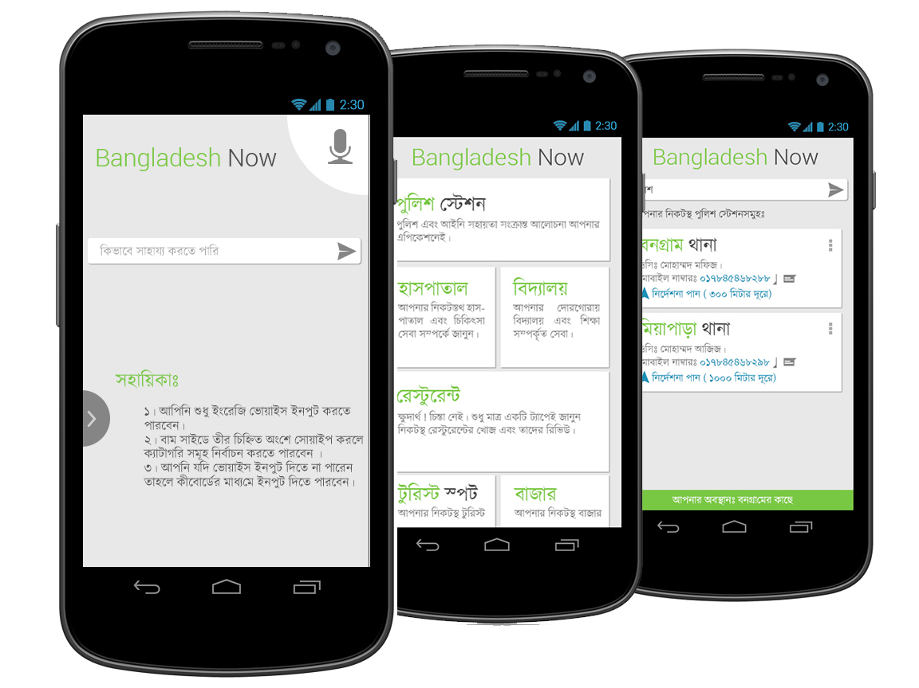

UI Mockup

Slide 8
Final Vision
A complete application with full Bangla and English support
Rich database with help of Google maps, foursquare and A2I Informations
Enrich google map
Bangla speech support (long term)

Slide 9
Support We need
Information from A2I as promised
Google Translate Premium account
One or two data entry operators

Slide 10
Team Information
Anam Ahmed ( Team Lead, North South University, anam.ahmed.a@gmail.com)
Ahmad Firoz ( UX Expert, South East University, admin@ahmadfiroz.com)
Prodhan Shishir ( Algorithm Expert, American Intl. University Bangladesh, pronerd@gmail.com)
Gazi Salahuddin Siddiquee ( Domain Expert, Agrani School & College)

